Slide 1




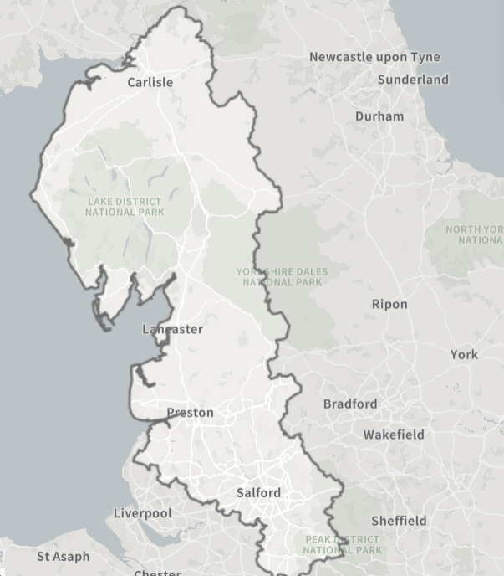
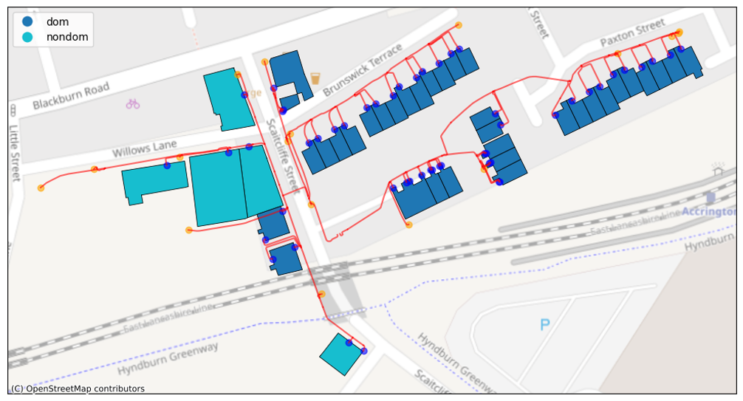

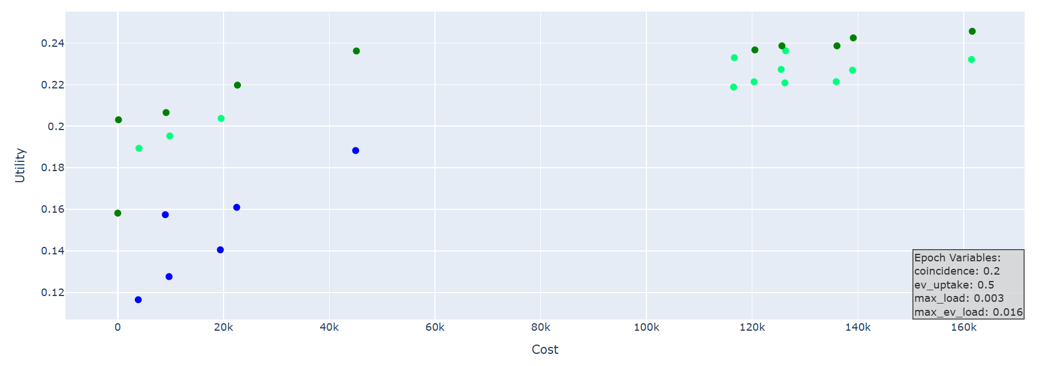



Comparing robustness and adaptability as ways to manage LV network optioneering under deep uncertainty
Adam Duncan PhD student– UCL
Supervisors : Prof David Shipworth, Dr Oliver Smith
The Problem
The Data
Important variables such as future demand shape are deeply uncertain
Network investments are expensive and long-lasting
Current optioneering approaches include limited uncertainty characterisation
GIS data of LV network for ENWL area
Mapped into format that can run power flow simulations (using PandaPower)
Service points linked to building data from 3Dstock model which records building type (domestic/commercial/mixed)
Question:
How can we quantify the relative merits of robust and adaptable LV network strategies when the energy transition pathway is unknown?
The Decision framework
Epoch Era analysis (EEA) is adapted to evaluate robustness and adaptability of different network design options under demand uncertainty.
Design definition
Epoch enumeration
Era construction
Value based comparison of competing decisions
Define a discrete set of network modifications to compare (e.g. reinforcement, flexibility)
Create a large set of possible scenarios for future demand
Concatenate the epochs to create possible timelines
The Outputs
An estimate of network headroom of ~23,000 UK LV networks in the Northwest of the UK
Epoch 1 of 400
Metrics of robustness and adaptability under demand uncertainty for different network design options across those LV networks
Possible adaptation pathways
Pareto frontier
Robustness - The fraction of epochs in which a given design option falls in the pareto frontier
Adaptability – The number of viable and beneficial adaptability pathways a design has
An analysis of how network topology and demand conditions influence the trade-off space between different design options
Oxford Energy Day
17 SEPTEMBER 2026

