Slide 1



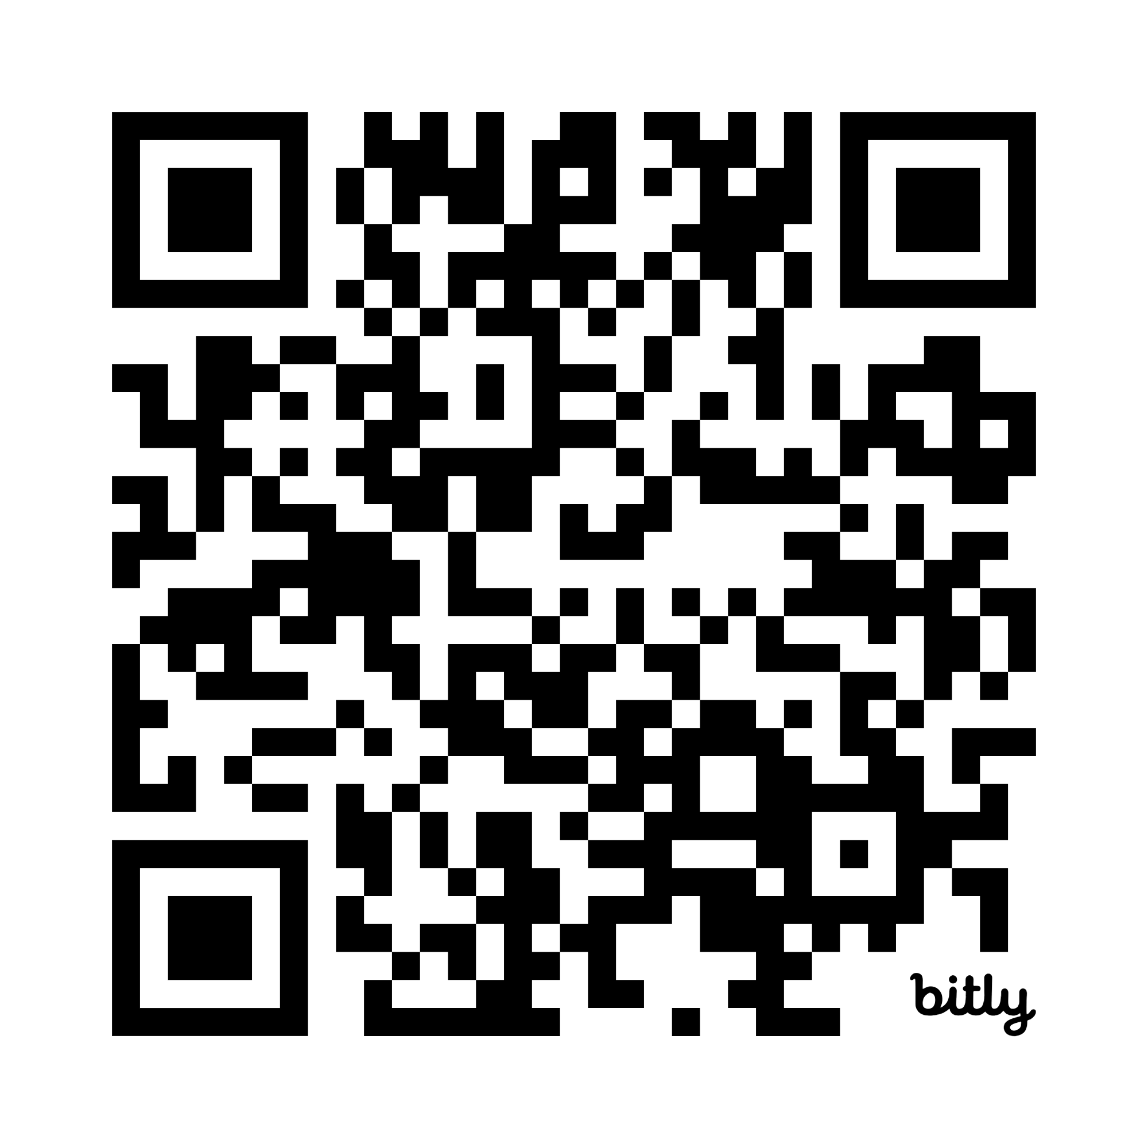
Seminar Series Michaelmas term 2025 5pm – 6.15pm School of Geography, Oxford University, OX1 3QY
Week 1: 14th October - Joe Kwiatkowski, Matched Energy - The Billion-Pound Opportunity to Make Clean Power 2030 More Affordable DESERT ROOM
Week 2: 21st October - Chetan Lad, E.ON UK – An energy supplier perspective from E.ON in the UK DESERT ROOM
Week 3: 28th October - Elizabeth Oliphant, Accure – Beyond the BMS: Leveraging predictive analytics for smarter energy storage DESERT ROOM
Week 4: 4th November – Tina Fawcett, ECI, University of Oxford – Energy Abundance: Powerful vision for a better future or a flawed fantasy DIVERSITY ROOM
Week 5: 11th November - Jesus Lizana, Engineering Science, University of Oxford – Innovations for zero-carbon heating and cooling: The path to net zero buildings by 2050 DIVERSITY ROOM
Week 6: 18th November – Dr Yee Van Fan, Environmental Change Institute, University of Oxford – Exploring digitalisation’s footprint DIVERSITY ROOM
Week 7: 25th November – Ian Byrne, IBECCS – Raising the Standard – Can international standard help save energy and carbon? DESERT ROOM
Week 8: 2nd December – Panel Discussion, James Durrant, Robert Hoye: Chemistry at Oxford and the Energy Transition: research contributions past and present, and future plans DIVERSITY ROOM

